Slide 1
Reinforced concrete structures
Unit – II
Limit State Design Method

Slide 2
Syllabus
INTRODUCTION TO LIMIT STATE DESIGN
Concept of limit state design
Characteristic loads
Characteristic strength
Partial load factor and material safety factors
Stress – Strain Curves
Assumptions
Stress Block Parameters
SINGLY AND DOUBLY REINFORCED BEAMS
Limit state analysis and design of Singly reinforced
and doubly reinforced beams.

Slide 3
Singly reinforced section
W kN / m
Compression
Tension

Slide 4
Stress-strain diagram of concrete
fck (Cube – 28 days of curing)
stress
0.67fck (strength of concrete in structure)
0.446fck (Design curve)
0.002
0.0035
strain

Slide 5



Stress-strain diagram of mild steel
Yield Plateau
stress
$$f_{y}$$
stress
$$0.87f_{y}$$
strain
Proof strain of 0.2% is recommended by IS 456
0.002 +$\frac{0.87f_{y}}{{Es}_{}}$
0.002
strain

Slide 6

Assumptions of limit state method
The plane section before bending remains plane after bending.
Maximum strain in concrete is 0.0035
Maximum strain in steel is
Tensile strength of concrete is ignored.
0.002 +$\frac{0.87f_{y}}{E_{s}}$

Slide 7

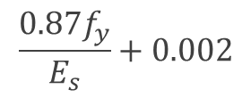
Stress block parameters
b
0.0035
0.446$f_{ck}$
C
d
D
T
$$\frac{0.87f_{y}}{E_{s}}+0.002$$
Strain
Diagram
Stress Diagram

Slide 8
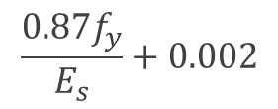
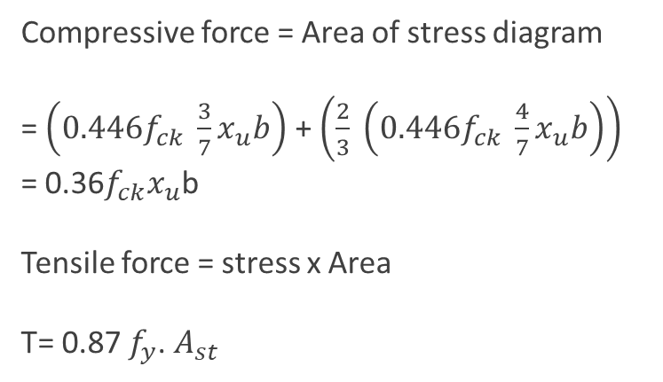


b
0.0035
0.446$f_{ck}$
C
d
D
T
$$\frac{0.87f_{y}}{E_{s}}+0.002$$
Strain
Diagram
Stress Diagram
ΔABO ≈ ΔPQO
$$\frac{0.002}{b}=\frac{0.0035}{x_{u}}$$
b= $\frac{4}{7}x_{u}$
a= $x_{u}$-b = $x_{u}−$ $\frac{4}{7}x_{u}$ = $\frac{3}{7}x_{u}$
Compressive force = Area of stress diagram
= $\left(0.446f_{ck} \frac{3}{7}x_{u}b\right)$ + $\left(\frac{2}{3} \left(0.446f_{ck} \frac{4}{7}x_{u}b\right)\right)$
= 0.36$f_{ck}x_{u}$b
Tensile force = stress x Area
T= 0.87 $f_{y}$. $A_{st}$

Slide 9
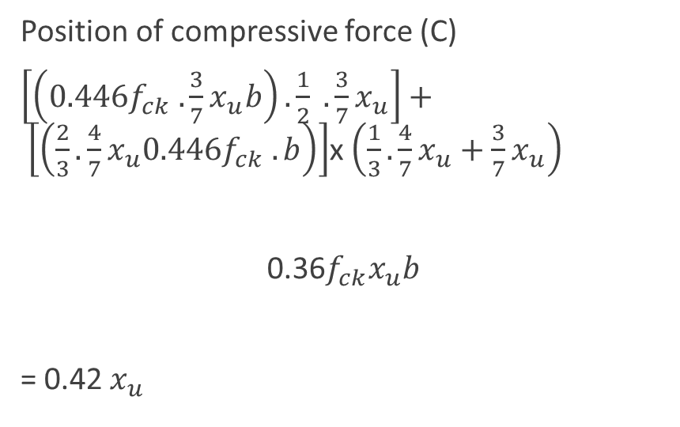
b
0.0035
0.446$f_{ck}$
C
d
D
T
$$\frac{0.87f_{y}}{E_{s}}+0.002$$
Strain
Diagram
Stress Diagram
Position of compressive force (C)
$\left[\left(0.446f_{ck} .\frac{3}{7}x_{u}b\right). \frac{1}{2} . \frac{3}{7}x_{u}\right]+ \left[\left(\frac{2}{3}.\frac{4}{7}x_{u}0.446f_{ck} .b\right)\right]$x $\left(\frac{1}{3}.\frac{4}{7}x_{u}+\frac{3}{7}x_{u}\right)$
0.36$f_{ck}x_{u}b$
= 0.42 $x_{u}$

Slide 10
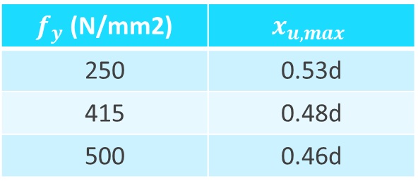



$x_{u}$ = depth of neutral axis
$x_{u,lim}$= limiting depth of neutral axis
0.0035
ΔABO ≈ ΔPQO
$$\frac{0.0035}{x_{u}}=\frac{0.002+ \frac{0.87f_{y}}{E_{s}}}{d−x_{u}}$$
$$x_{u,lim}= \frac{0.0035d}{0.0055+ \frac{0.87f_{y}}{E_{s}}}$$
d
$$\frac{0.87f_{y}}{E_{s}}+0.002$$
$f_{y}$ (N/mm2) | $$x_{u,max}$$
250 | 0.53d
415 | 0.48d
500 | 0.46d

Slide 11
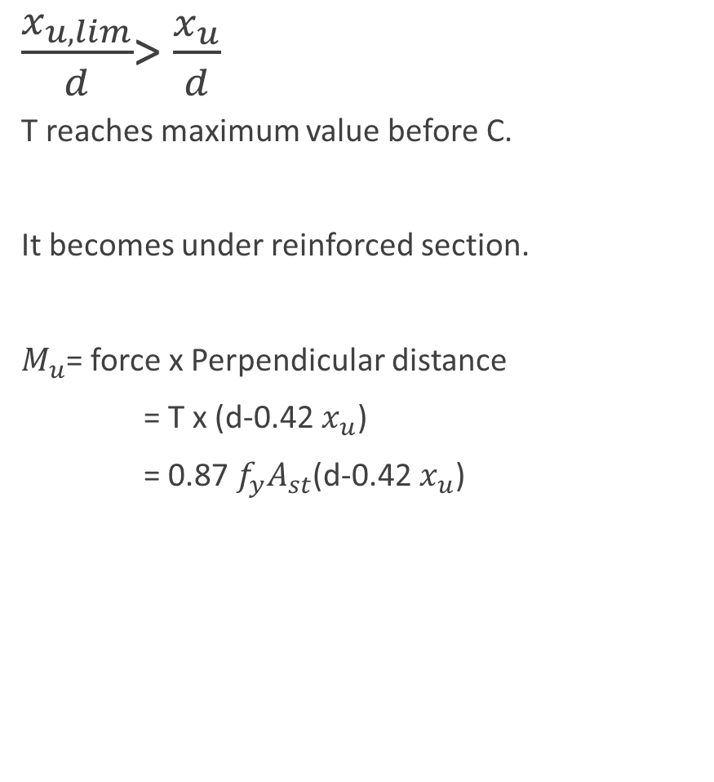
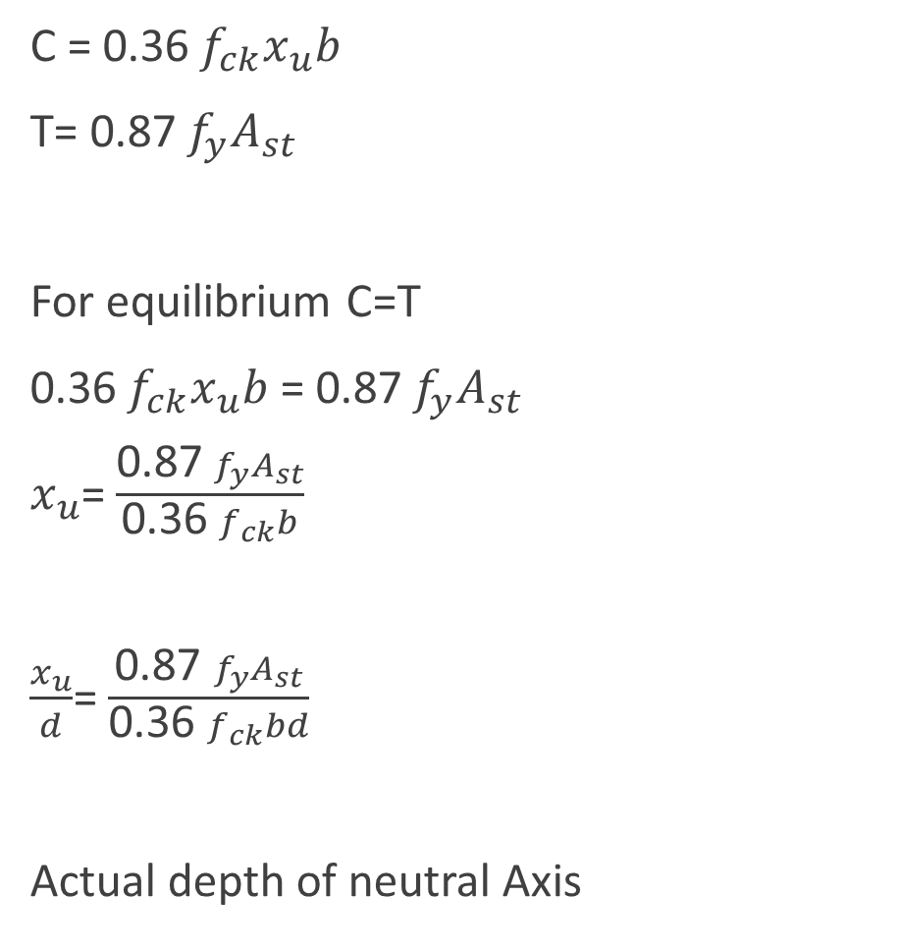
C = 0.36 $f_{ck}x_{u}b$
T= 0.87 $f_{y}A_{st}$
For equilibrium C=T
0.36 $f_{ck}x_{u}b$ = 0.87 $f_{y}A_{st}$
$x_{u}$= $\frac{\text{0.87 }f_{y}A_{st}}{\text{0.36 }f_{ck}b}$
$\frac{x_{u}}{d}$= $\frac{\text{0.87 }f_{y}A_{st}}{\text{0.36 }f_{ck}bd}$
Actual depth of neutral Axis
$\frac{x_{u,lim}}{d}$> $\frac{x_{u}}{d}$
T reaches maximum value before C.
It becomes under reinforced section.
$M_{u}$= force x Perpendicular distance
= T x (d-0.42 $x_{u}$)
= $\text{0.87 }f_{y}A_{st}$(d-0.42 $x_{u}$)

Slide 12
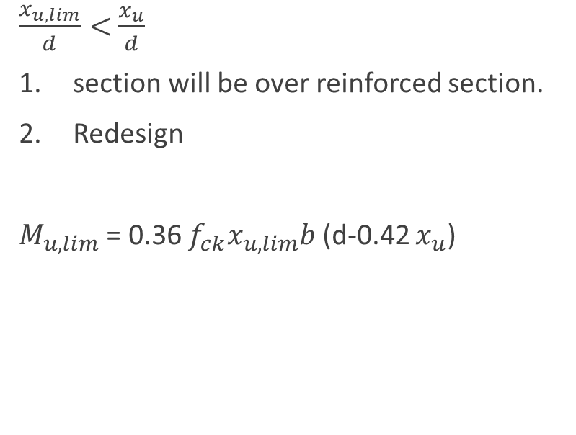

$\frac{x_{u,lim}}{d}=$ $\frac{x_{u}}{d}$ (Balanced section)
Actual N.A = Limiting Neutral Axis
Moment = T x Lever Arm = C x Lever Arm
= $\text{0.87 }f_{y}A_{st}$(d-0.42 $x_{u}$) = 0.36 $f_{ck}x_{u}b$ (d-0.42 $x_{u}$)
$\frac{x_{u,lim}}{d}<$ $\frac{x_{u}}{d}$
section will be over reinforced section.
Redesign
$M_{u,lim}$ = 0.36 $f_{ck}x_{u,lim}b$ (d-0.42 $x_{u}$)

